Slide 1


CNS WHO CLASSIFICATION FROM A CLINICIAN`S PERSPECTIVE: HOW DOES IT CHANGE MY PRACTICE?
DR. GABRIEL BATISTELLA
HOSPITAL HCOR / EPM UNIFESP

Slide 2
Declaração de Conflito de Interesse
None
Exigência da RDC Nº 96/08 da ANVISA

Slide 3
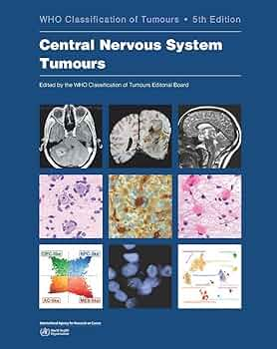
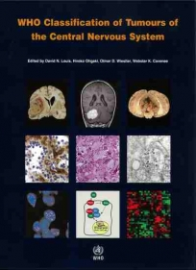
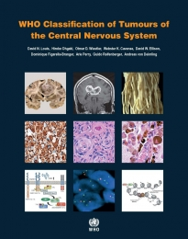
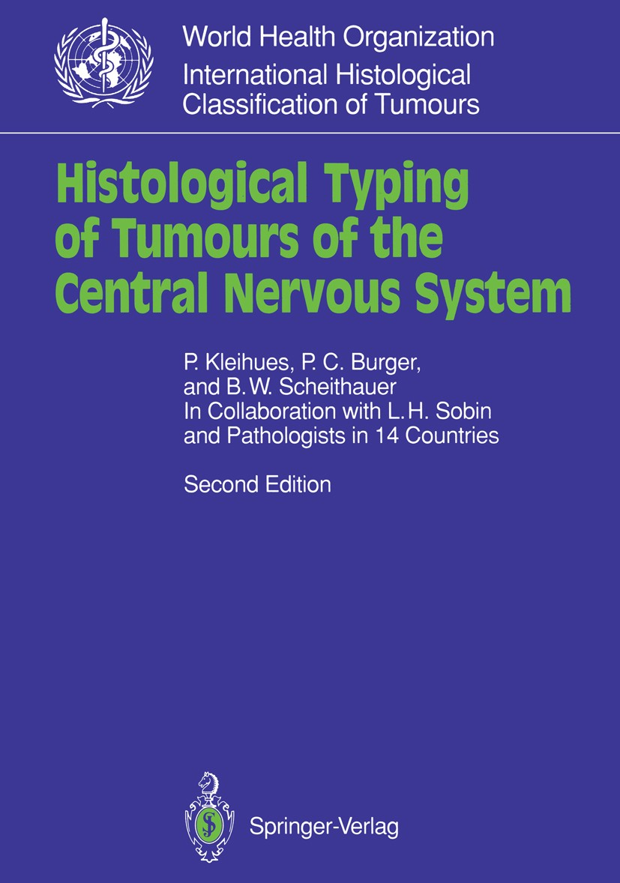
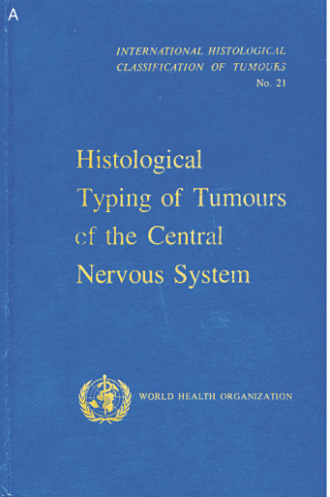
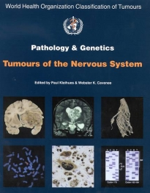
2021
2007
2016
1993
1979
2000

Slide 4
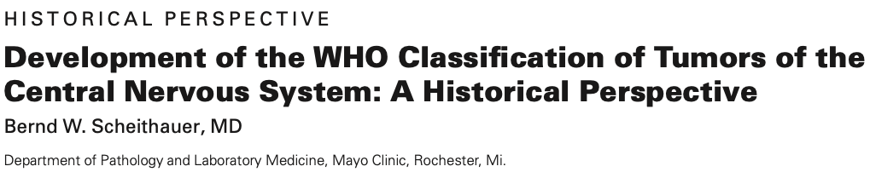
1979 -> 2007
1979 – GBM was not yet in the category of astrocytomas (but rather in poorly differentiated or embryonic tumors), but it was already mentioned and defined similarly to today. Giant cell GBM was both a tumor entity and a subtype of GBM (monstrous cell sarcoma, - tumors of blood vessel origin).
1993 – PXA added to the classification. GBM became a tumor within the astrocytic spectrum. Anaplastic oligoastrocytoma was recognized.
2000 – Few substantial changes
2007 – Pilomyxoid astrocytoma as a subtype of PA. Term GBM with oligodendroglial component. Papillary tumor of the pineal region added, extraventricular neurocytoma, rosette-forming glioneuronal tumor

Slide 5
2021
2007
2016
1993
1979
2000

Slide 6

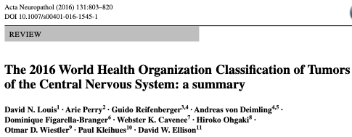

2016 and 2021!
The current 2021 classification was built upon the knowledge gained from the review of the 4th classification published in 2016.
Advances in the classification of CNS tumors through molecular data combined with histopathological data.
Tumors classified biologically and molecularly better, with a better understanding of the natural history of each tumor type.
Changes in taxonomy and nomenclature, new types, and tumor subtypes.
New challenges are clearly visible, both in classification and in its implementation in daily practice.

Slide 7
2016 and 2021!
Taxonomy now hybrid
Tumor types readily characterized and defined by molecular alterations (Oligodendroglioma, IDH mutated, and 1p19q codeleted)
Some tumors have their diagnosis strengthened by molecular parameters (Papillary craniopharyngioma – BRAF)
Others are rarely diagnosed using molecular data (Subependymoma)
Tumor grading among tumor types
The classification is in full evolution!

Slide 8

WHO CNS TU CLASSIFICATIONS – EVERY 7-10 YEARS, A NEW EDITION!
Imagem criada por DALL-E 2, baseada em uma descrição fornecida pelo usuário. Maio de 2024.

Slide 9
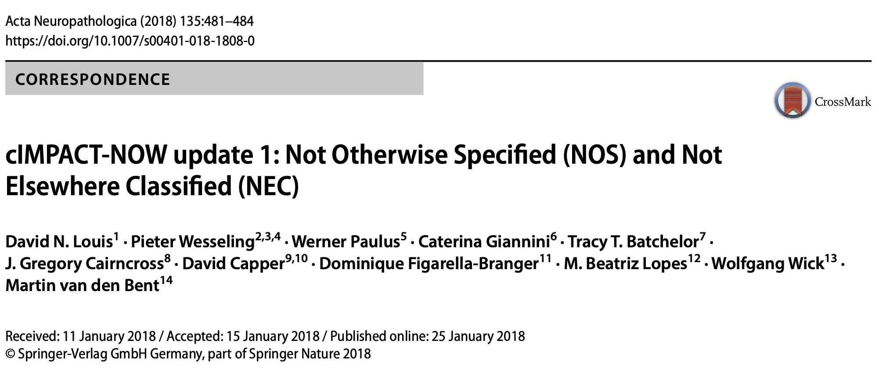
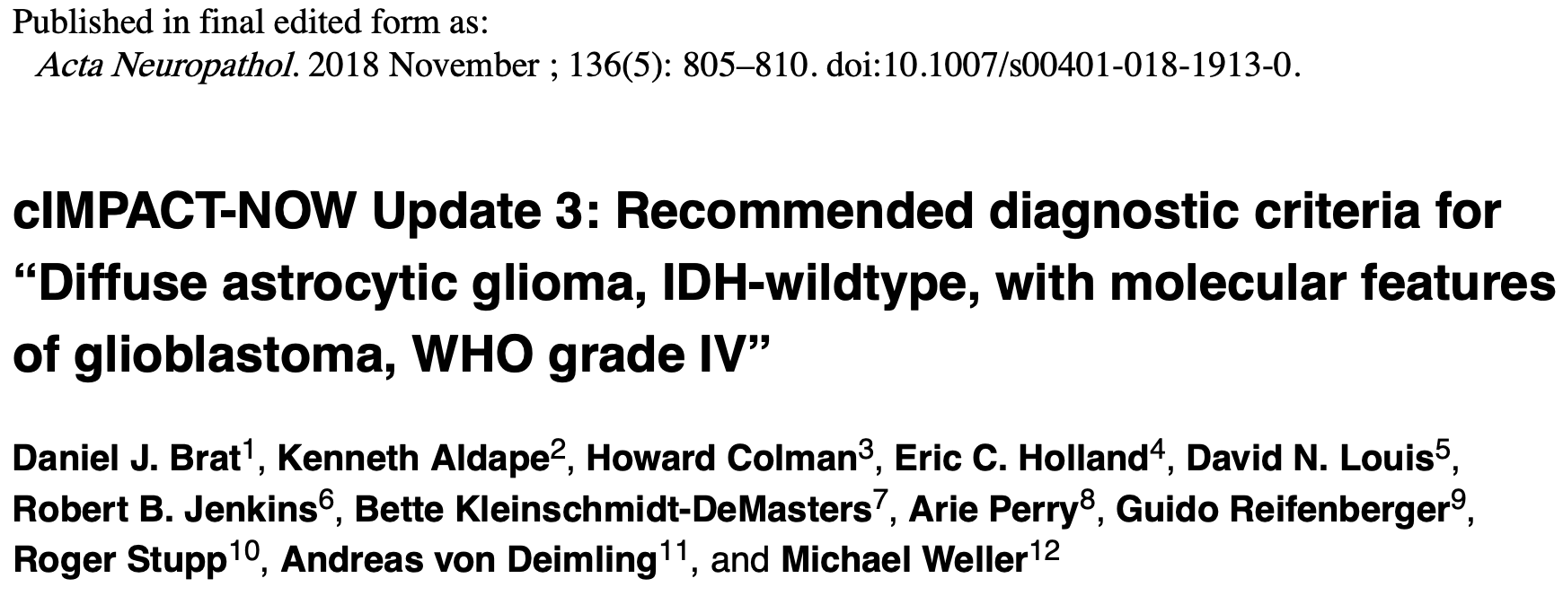
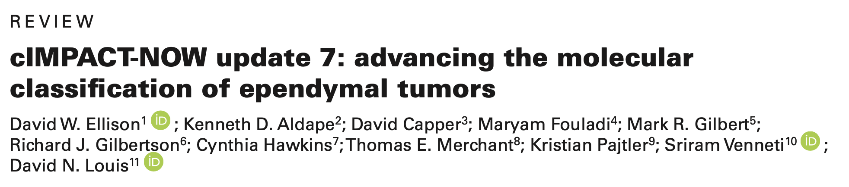
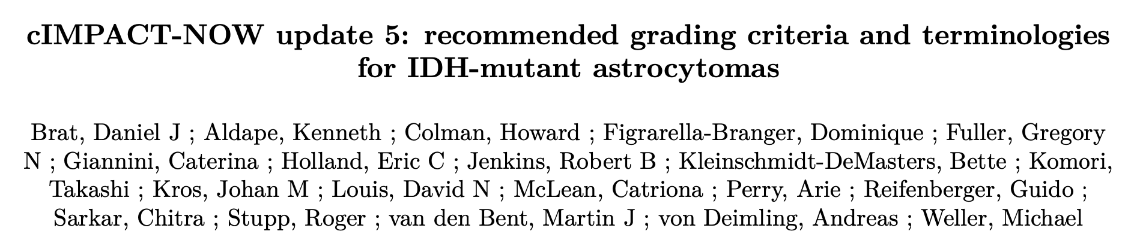
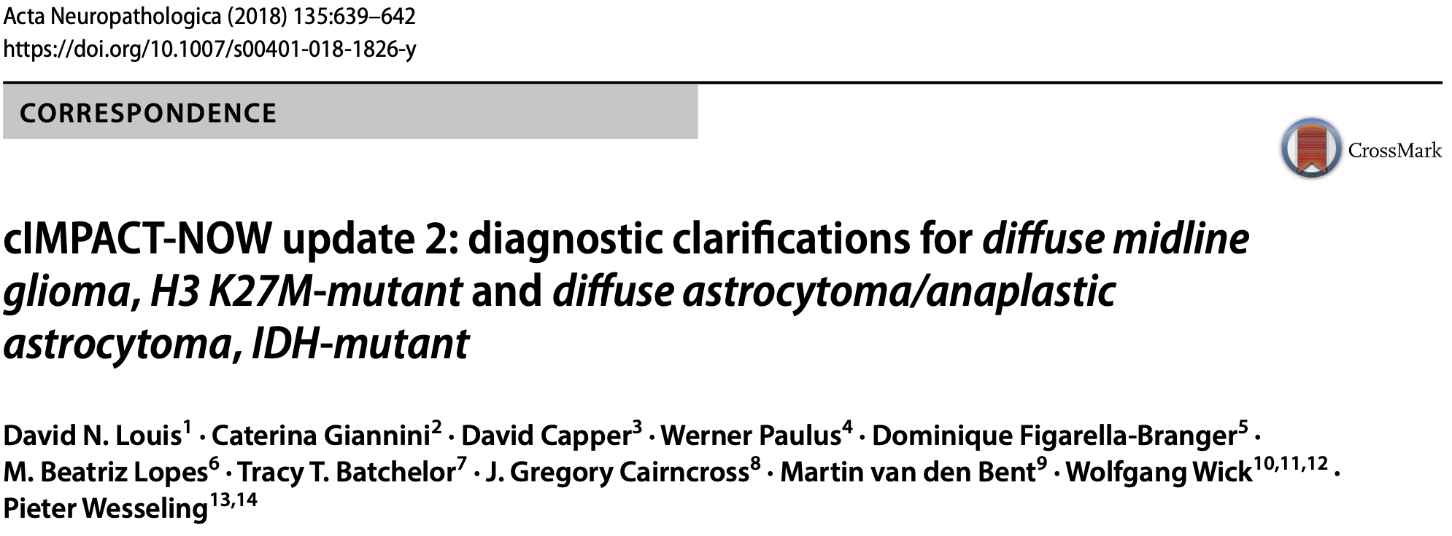
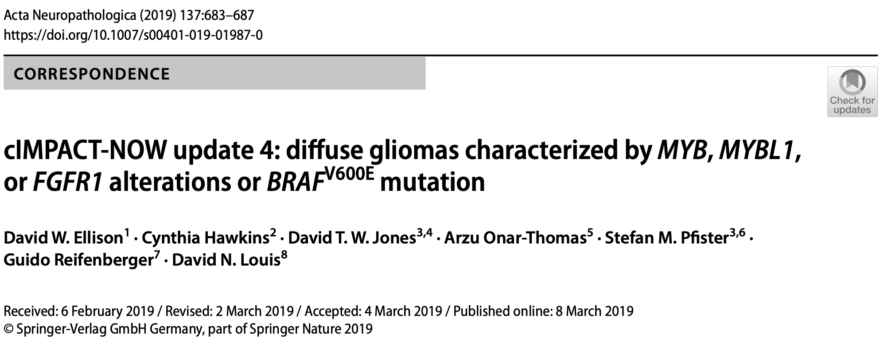
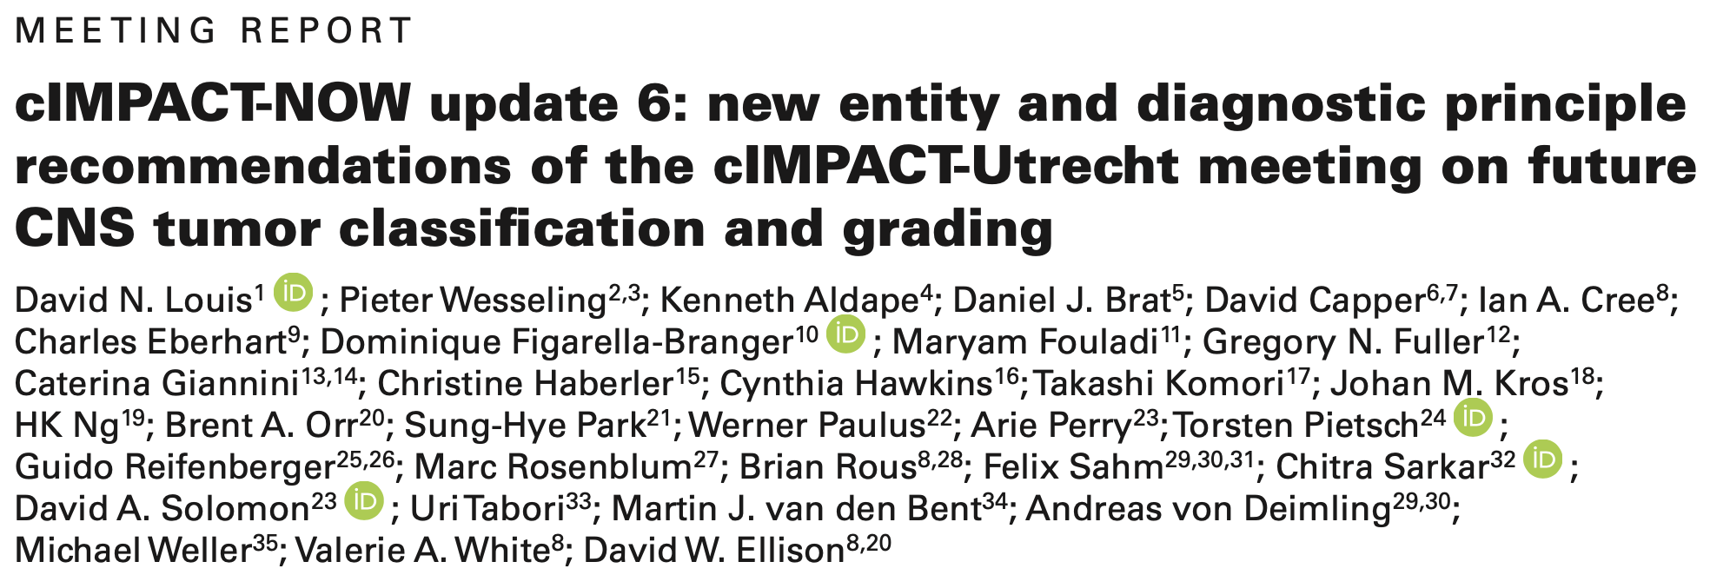
cIMPACT-NOW (2016 ->

Slide 10
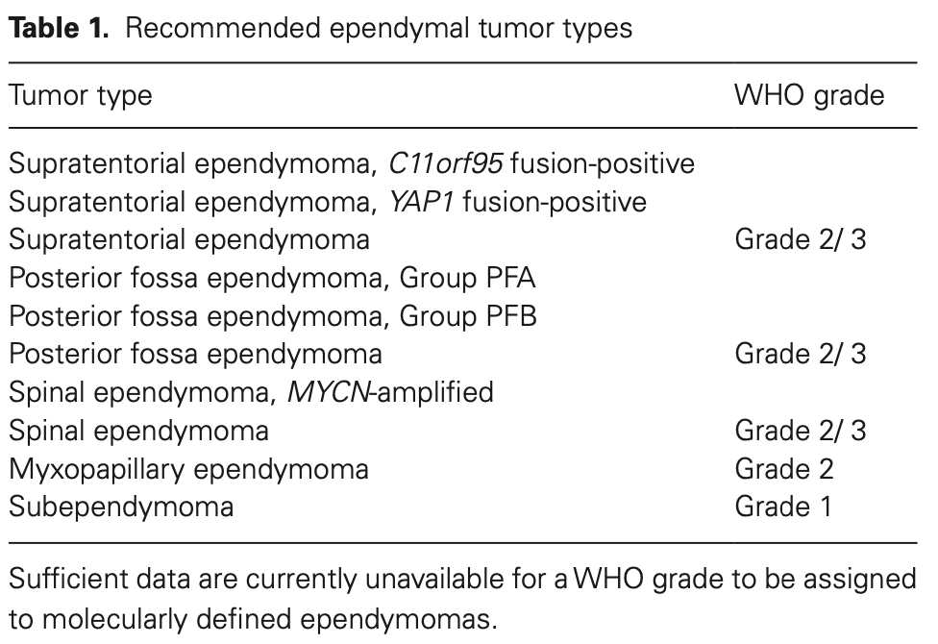
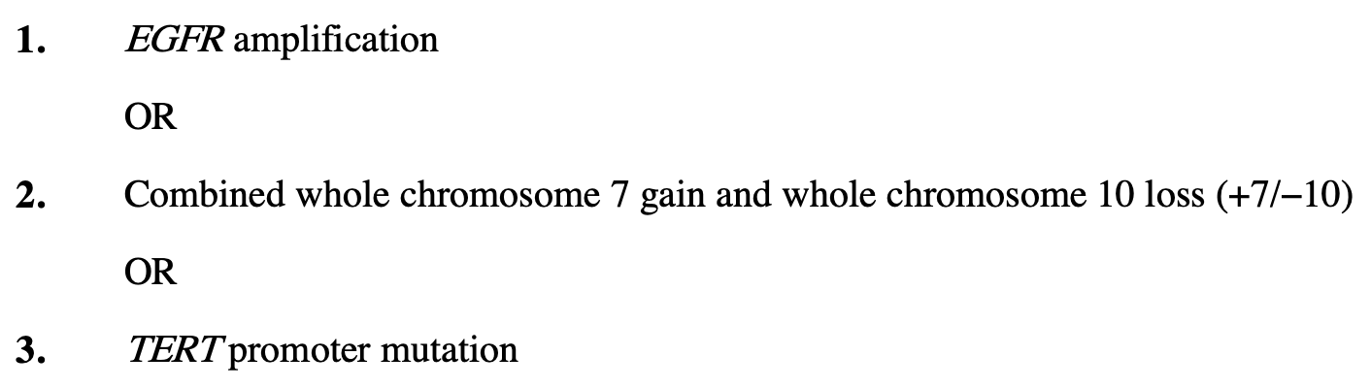
cIMPACT-NOW
Addresses the heterogeneity among IDH-wt/H3-wt diffuse gliomas in pediatric-type diffuse gliomas
25/01/2018
NOS and NEC
Diffuse midline glioma, H3K27M-mutant defined
+
No need to test for 1p19q codeletion if ATRX expression is lost +- p53 + (mutated) in diffuse IDH-mutated astrocytomas
The glioblastoma term should be used for those diffuse astrocytic gliomas that are IDH-wt + hist or mol features of GBM.
Diffuse astrocytic gliomas IDH-mutated can be graduated to correspond to grade 2-4 (CDKN2A/B)
Arabic vs Roman numerals
Defines diffuse astrocytic glioma, IDH-wt, with molecular features of GBM, WHO grade 4

Slide 11


IMPORTANT FIRST STEP IN A
NEURO-ONCOLOGY CONSULT
NOS / Not otherwise specified
The diagnostic information necessary to assign a WHO diagnosis is not available, providing an ALERT to the neuro-oncologist that a molecular work-up has not been undertaken or failed technically
NEC / Not elsewhere classified
Indicated that the necessary diagnostic testing has been successfully performed but the results do not readily allow for a WHO diagnosis
Integrated and layered diagnosis
Due to the growing importance of molecular information in CNS tumor classification, diagnostic reports (and diagnosis) need to combine data into a single, “integrated” diagnosis

Slide 12
FACING WHO CNS 2021 IN BRAZIL
PRIVATE PRACTICE
Vs.
HOSPITAL PRACTICE
MOLECULAR TESTS ARE NOT COVERED BY
MEDICAL INSURANCE PLANS
PUBLIC HEALTH SYSTEM
(SUS)
PERSONALIZED THERAPY FOLLOWING AN ACCURATE DIAGNOSIS. WILL IT REALLY HAPPEN?
MAKING PATIENTS UNDERSTAND WHAT THEY ARE FIGHTING, AND FOR HOW LONG

Slide 13
DIAGNOSTIC CHALLENGES IN NEURO-ONCOLOGY
Tumor sample usually in small volume – worn out piece after traditional histopathology
Morphological overlap of various tumor types
Lack of specific immunohistochemical and molecular alterations for most tumor types
KIAA1549::BRAF – Pilocytic astrocytoma, High-grade astrocytoma with pilocytic features (HGAP), Diffuse leptomeningeal glioneuronal tumor (DLGNT)
BRAF V600E– Ganglioglioma (GG), Pleomorphic xanthoastrocytoma (PXA), Polymorphous low-grade neuroepithelial tumor of the young (PLNTY), Glioblastoma (GBM)
pTERT – Glioblastoma, Oligodendroglioma, High-grade PXA, rare HGAPs
CDKN2A/B HD – PXA, GBM, High-grade IDH-mutant diffuse gliomas, ZFTA-fused Ependymomas, etc.

Slide 14
Diffuse astrocytic LGG IDH-wt – How are we dealing with them?
cIMPACT-NOW update 3 (Nov 2018) – We need to rule out glioblastoma (EGFR amplification or +7-10 or TERT promoter mutation – take care with this statement)
Midline tumors: rule out DMG H3K27M altered tumors (H3K27M, H3K27me3, EGFR, EZHIP)
Hemispheric tumors: check for H3 G34 (usually are MGMT methylated)
Talk to your neuropathologist again: are we sure it is not a neuronal/glioneuronal tumor? Is it diffuse, or could it be a circumscribed glioma? (BRAF V600E, CDKN2A/B, BRAF::KIAA1549, MYB/MYBL, FGFR)
NTRK fusions
TAKE CARE WITH FALSE NEGATIVE IDH1 R132H IH!
pTERT mutation in isolation: is it sufficient to diagnose glioblastoma?
Methylation profiling

Slide 15
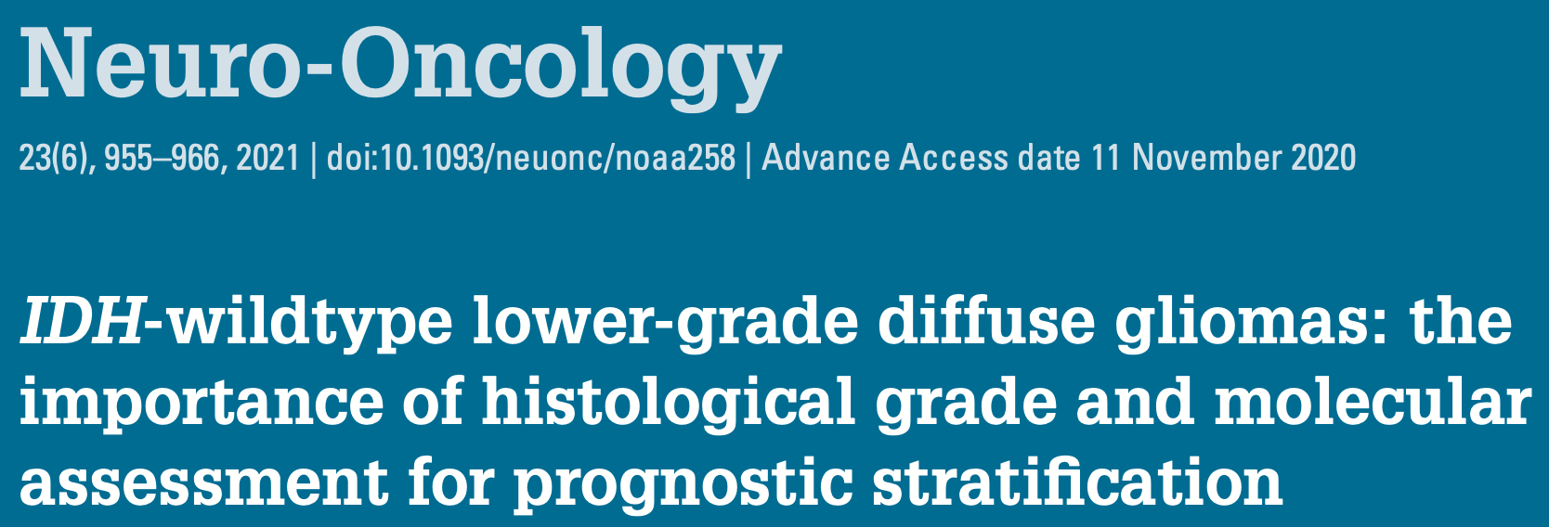
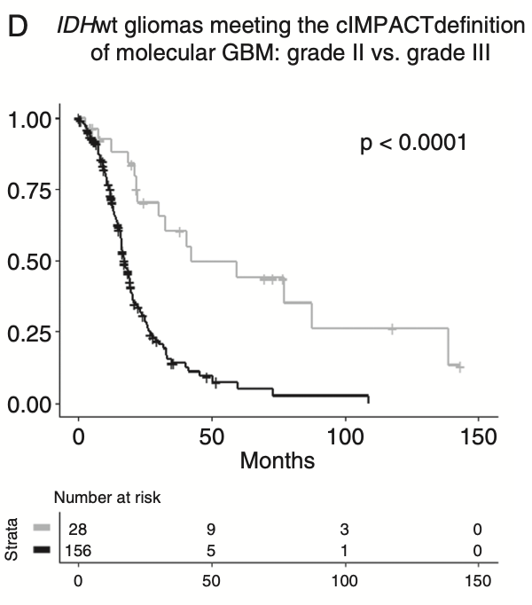
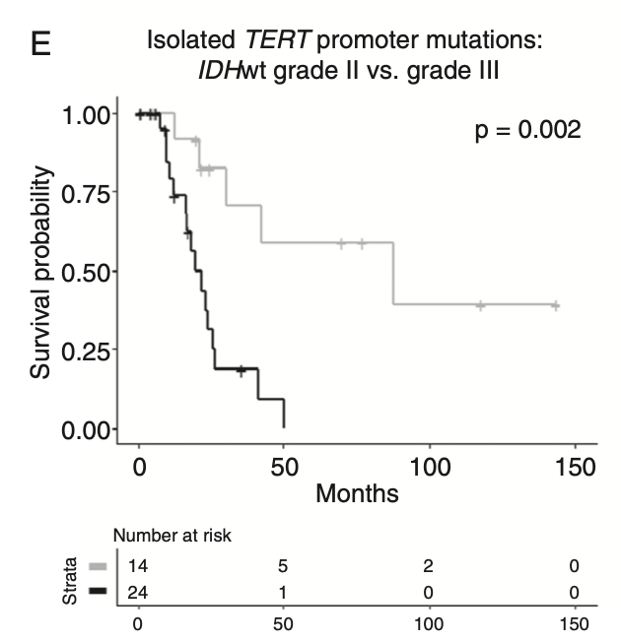
This highlights the importance of histological grade for the prognostic stratification of IDH-wt lower-grade gliomas.
CLEARLY, WE NEED TO LEARN MORE ABOUT THIS TUMORS!
Among 517 grade 2 gliomas, 47 were diffuse astrocytomas IDH-wt.
mOS 59 months vs 19 months IDH-wt grade 3
67% (29 patients) met criteria for GBM according to cIMPACT-NOW update 3. (mOS 42 months)
16 patients with isolated pTERT mutation (mOS 88 months) – are they really GBMs????
FGFR3-TACC3 overrepresented among grade 2 IDH-wt

Slide 16
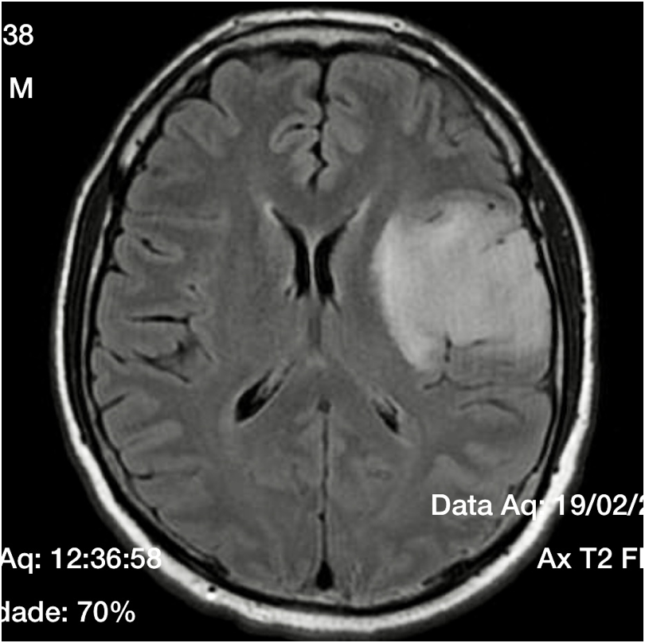
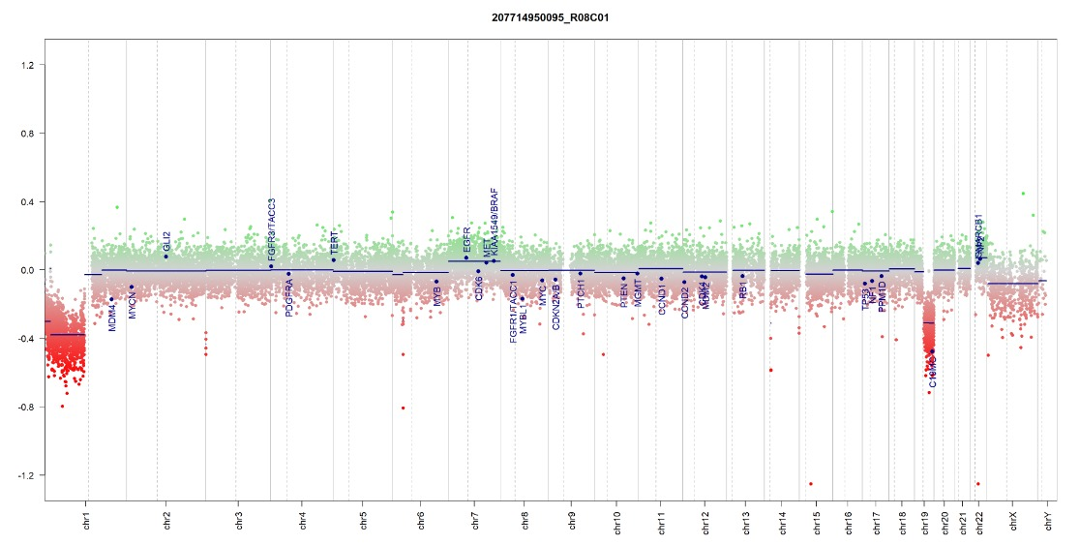
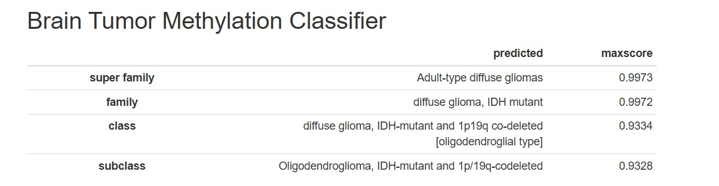
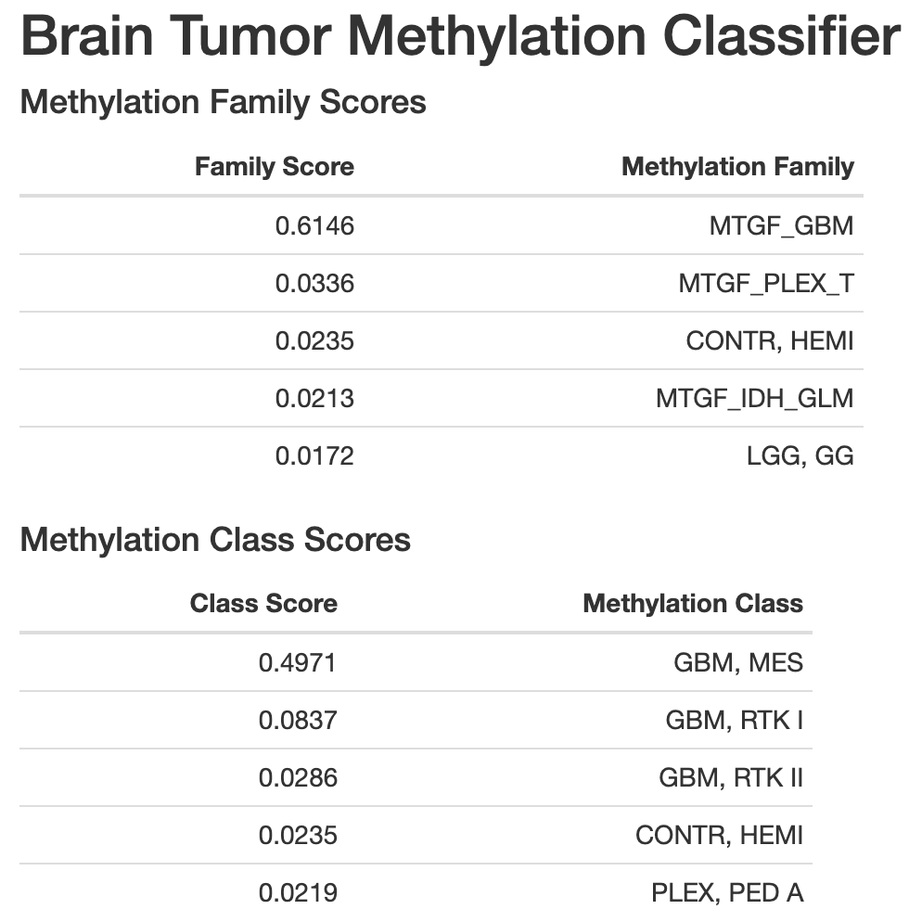
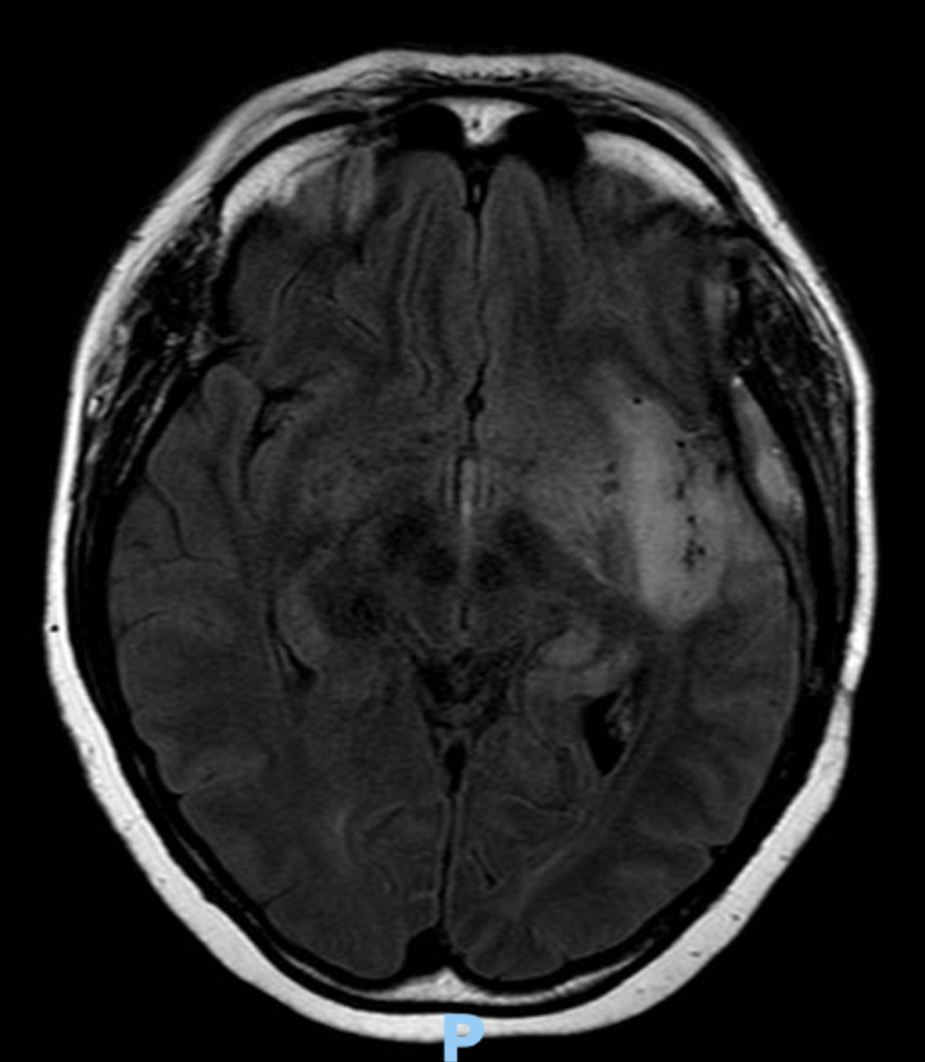
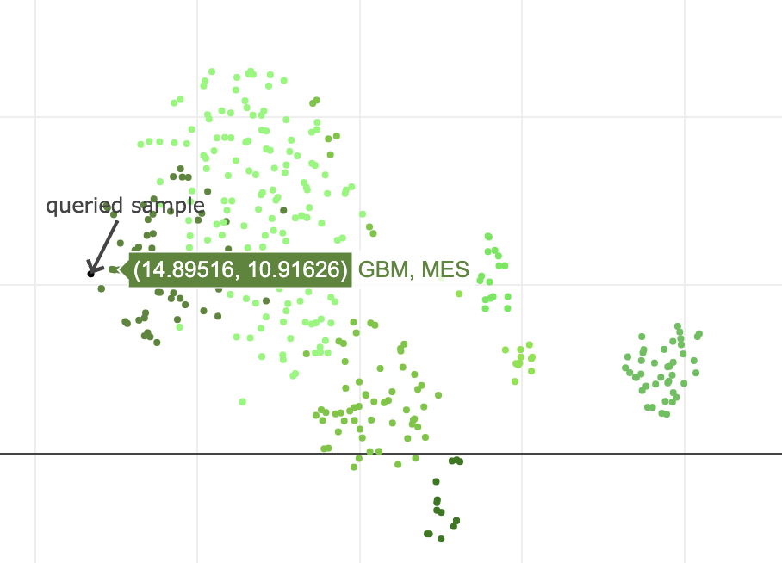
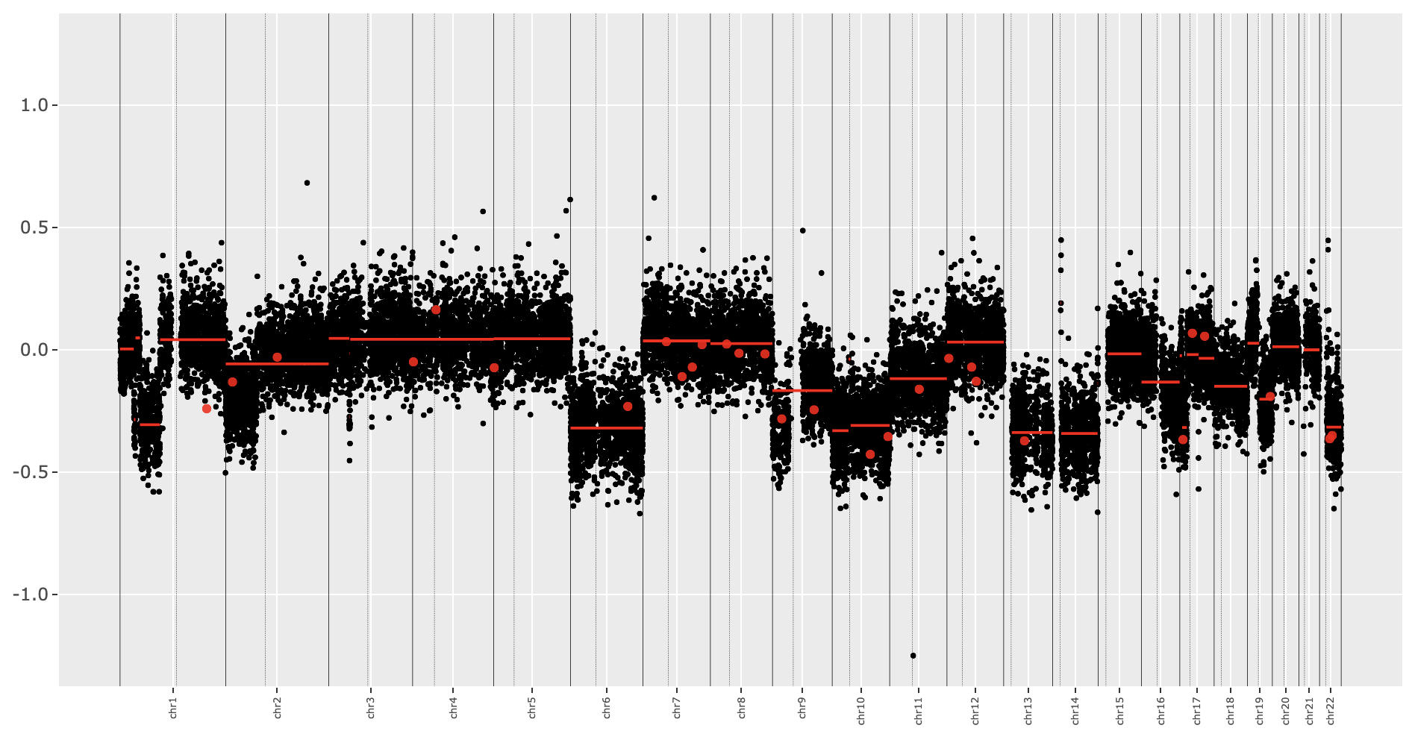
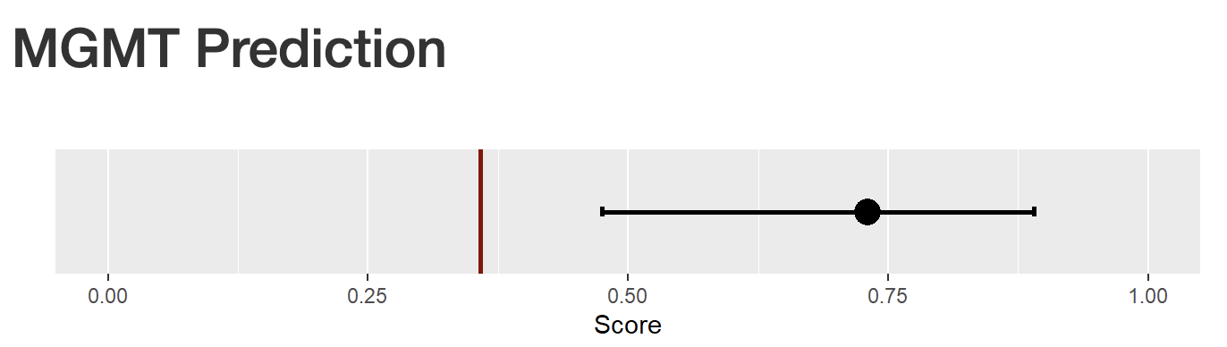
Ki67 5%, GFAP+, IDH-wt (IH), OLIG2+, P53 neg
AP: oligo-like
NGS IDH1 mut
IH revised: error in IH, it was positive!
52 yo-male
Ki67 1%, GFAP+, OLIG2+
IDH (IH) negative
ATRX expression retained
P53 wt
AP suggestive of a diffuse astrocytic low-grade tumor
pTERT+
EGFR mut
NF1 mut (germ negative)
PTEN P53
44 Yo-female

Slide 17
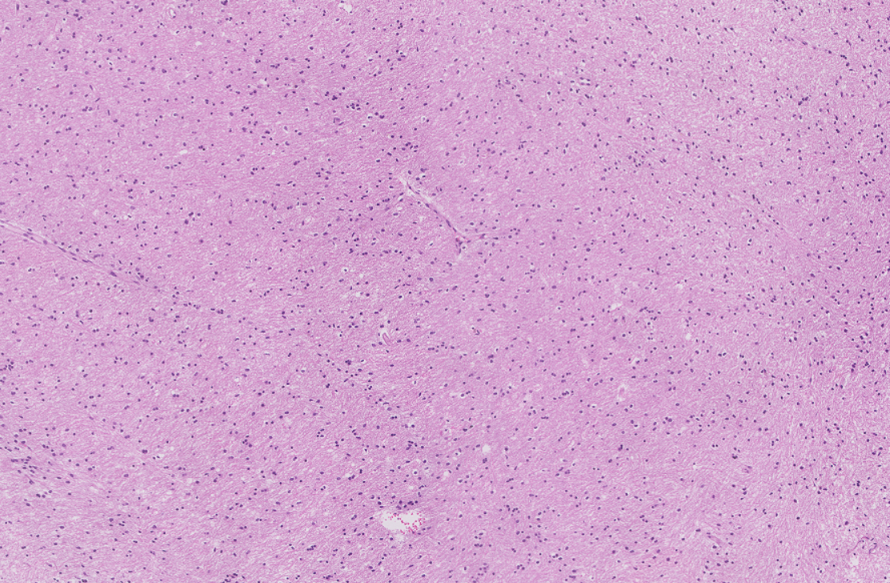
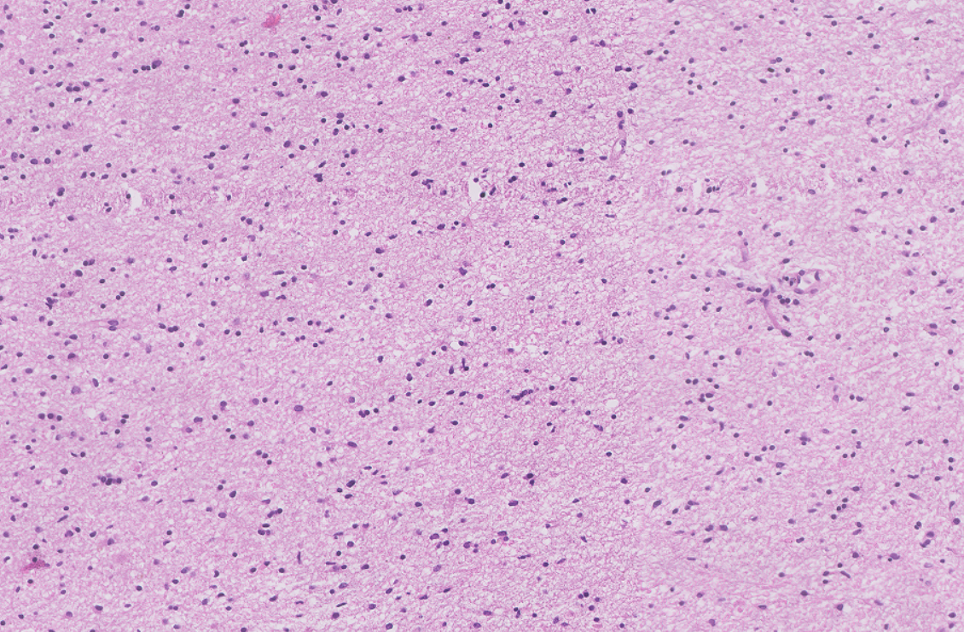
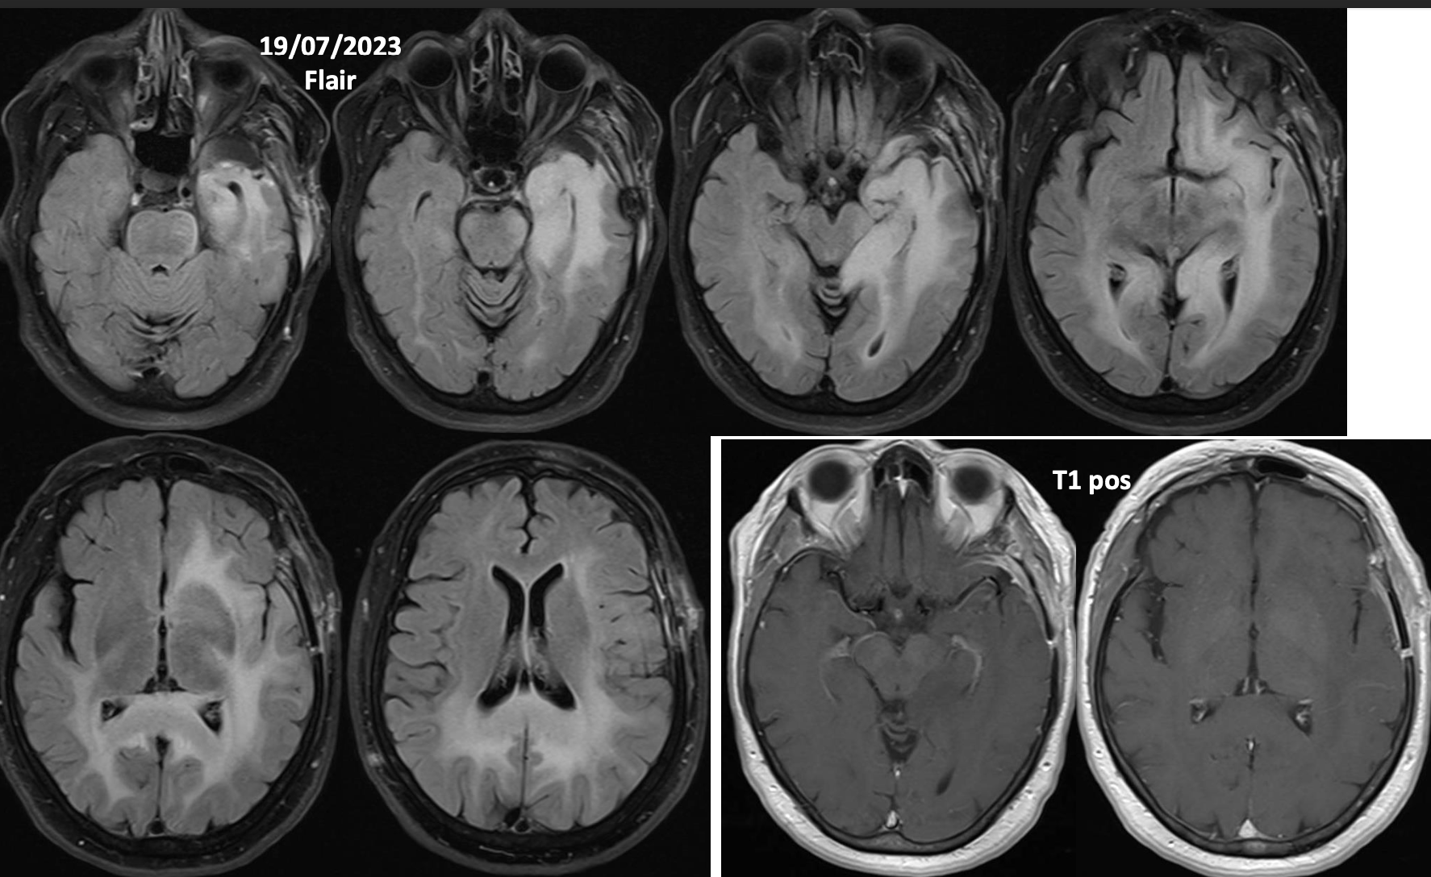
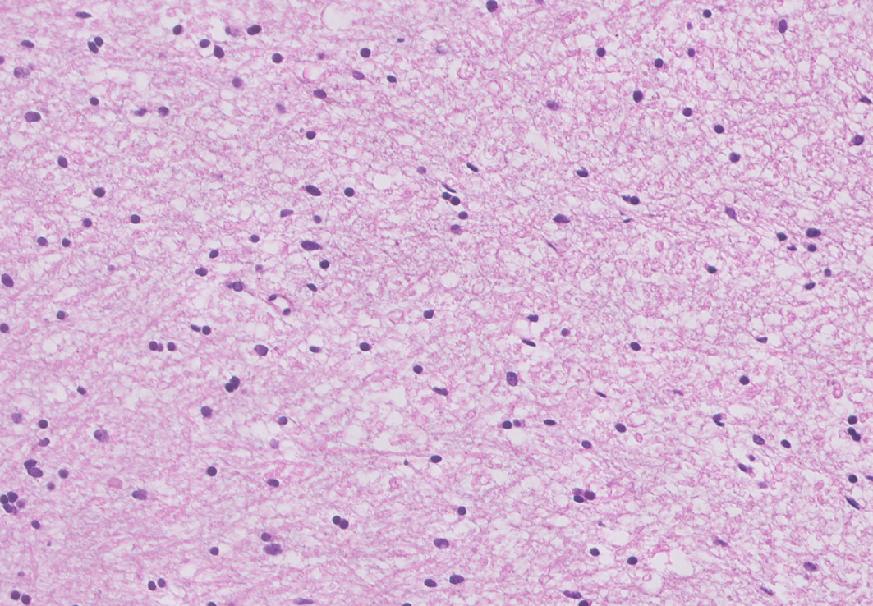
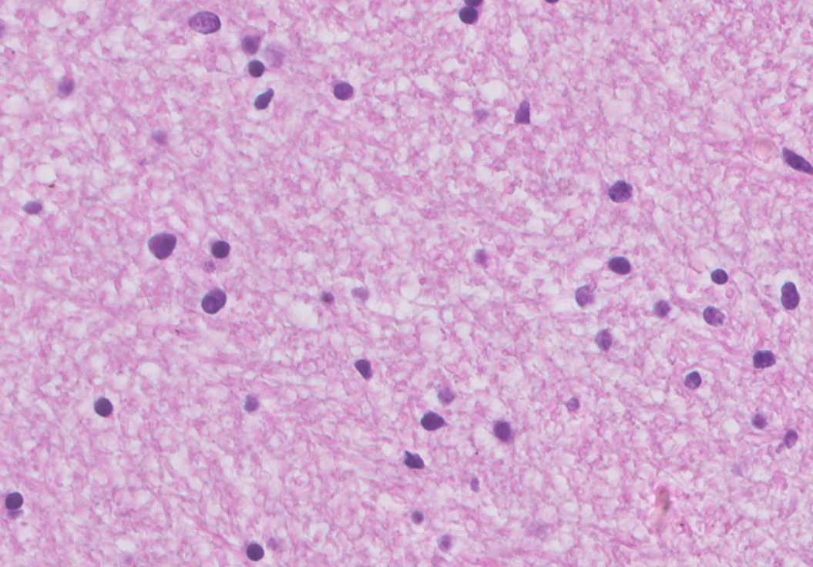
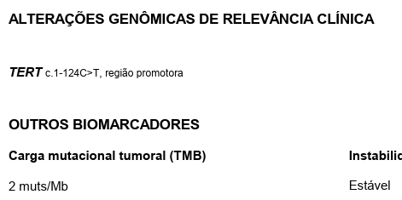
The isolated pTERT issue
71 yo-female
April 23 – confusion, nausea and headaches
May 23 – A diffuse expansive lesion with gliomatosis cerebri pattern showed in a brain MRI

Slide 18
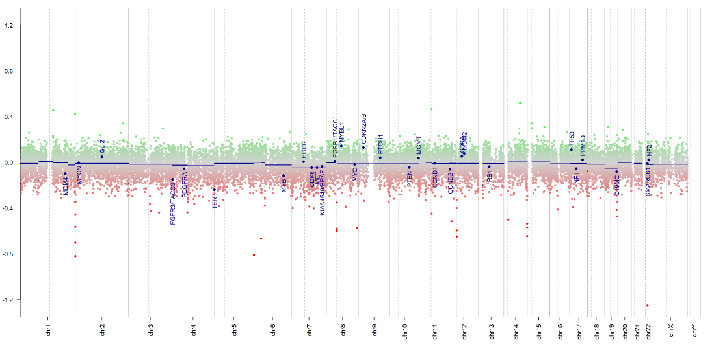
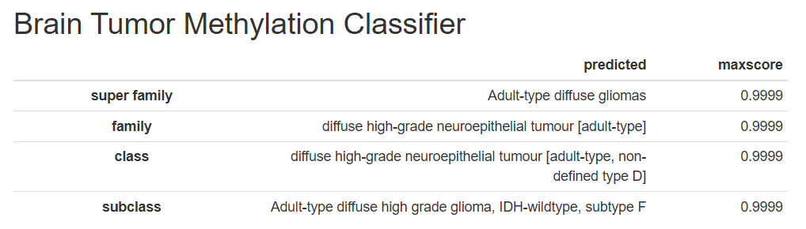
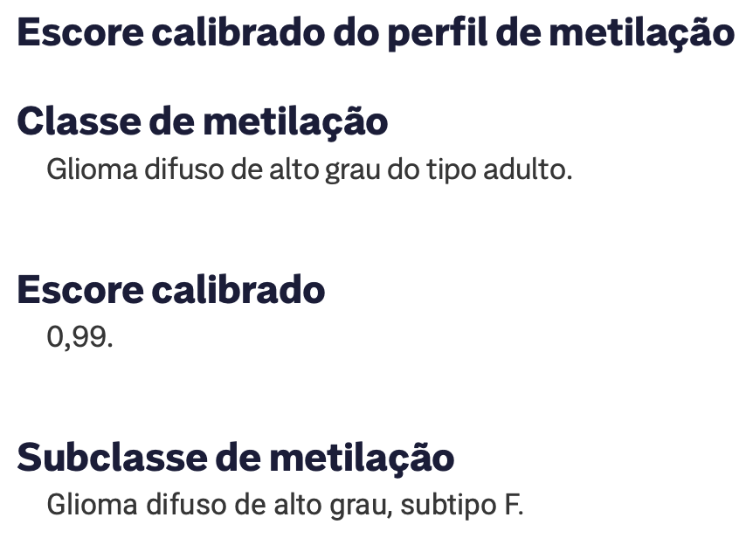
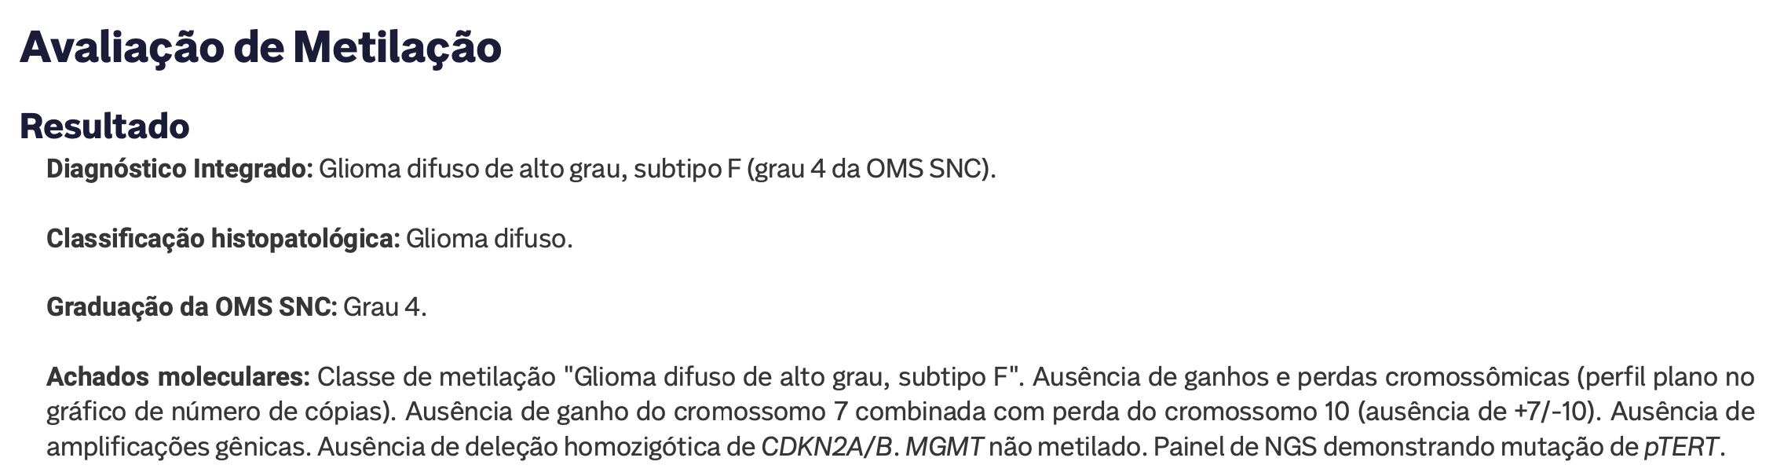
The isolated pTERT issue

Slide 19

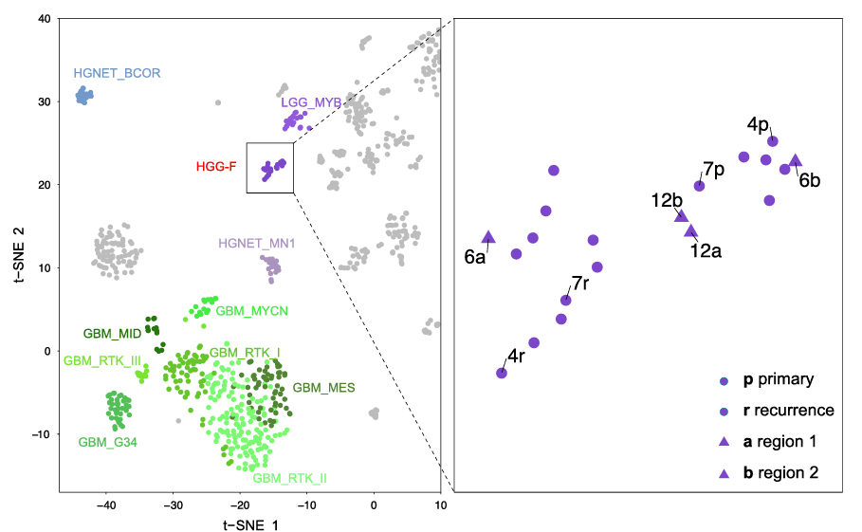
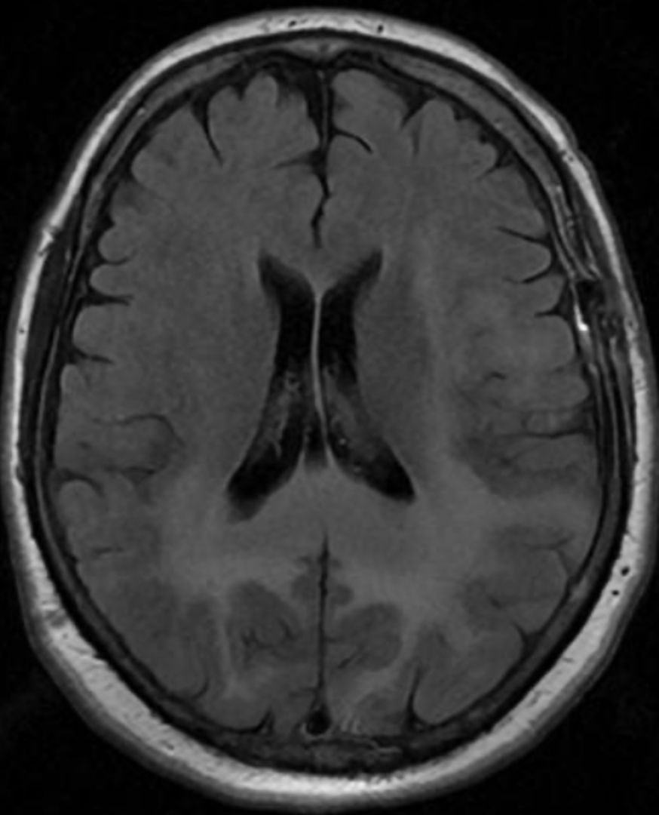
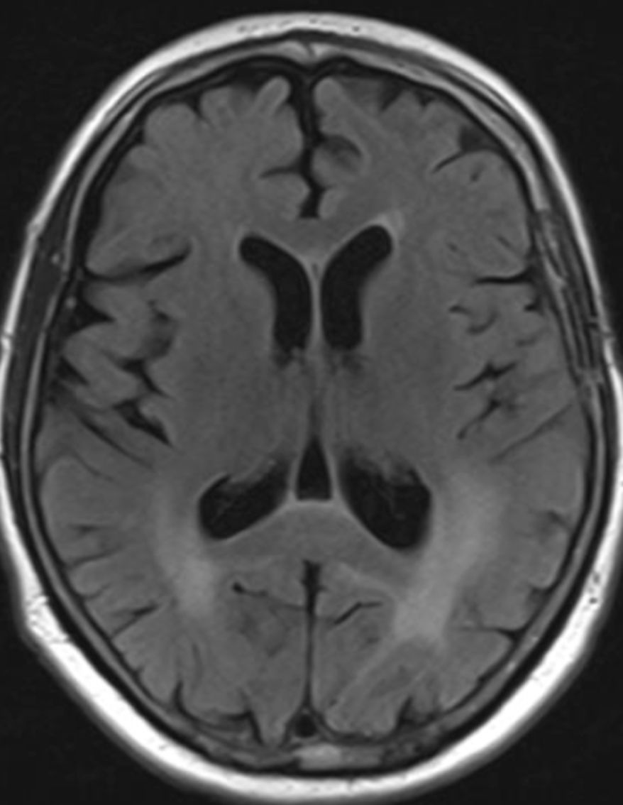
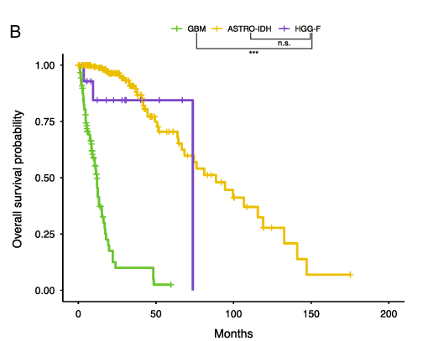
June 2023
Jan 2024

Slide 20
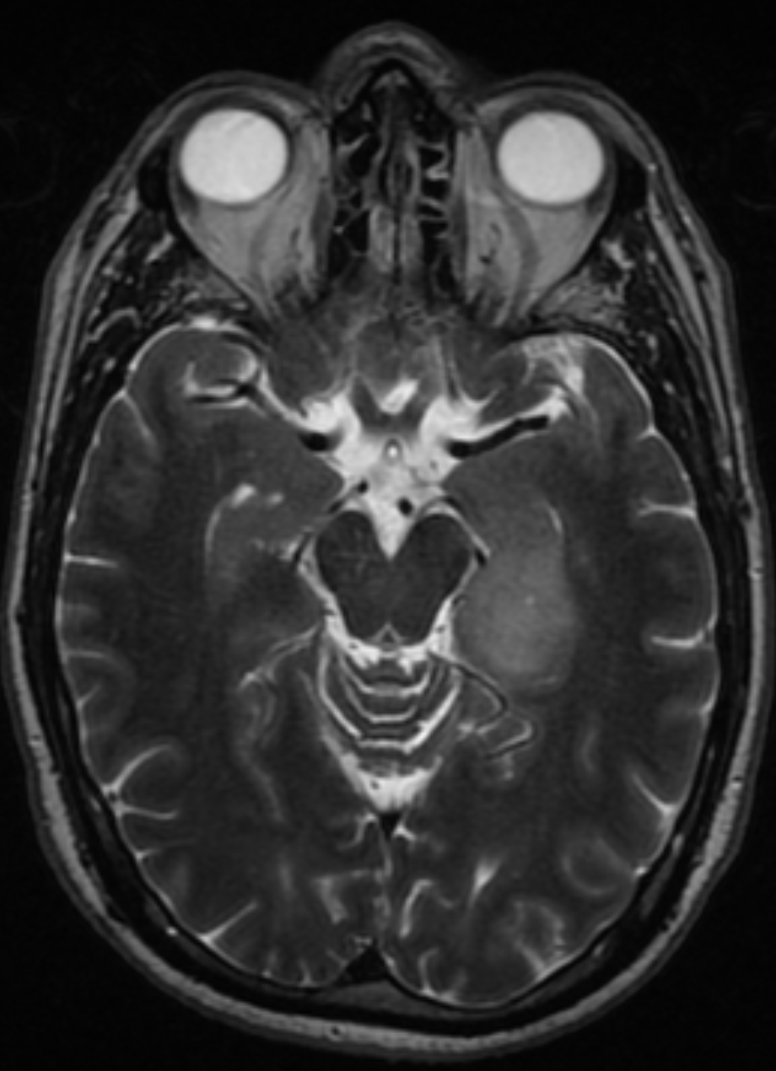
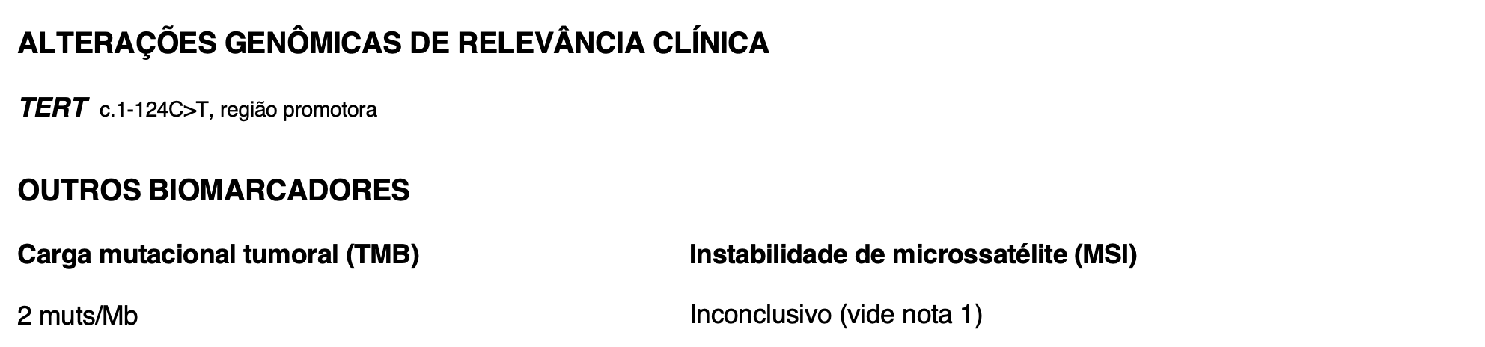
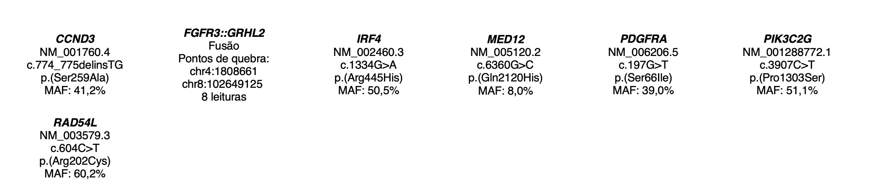
The isolated pTERT issue – Search for fusions
59 yo-male, ophthalmologist, presented with an epileptic seizure on Jan 2022 while working
Brain MRI disclosed an expansive lesion on his left temporal lobe, consistent with a LGG
Mitosis: absent
Necrosis: absent
IHC summary – GFAP+, Olig2+, IDH1-, ATRX retained, p53 focal and Ki-67 1-2%
NGS panel (500 genes): TERT c.1-124C>T

Slide 21
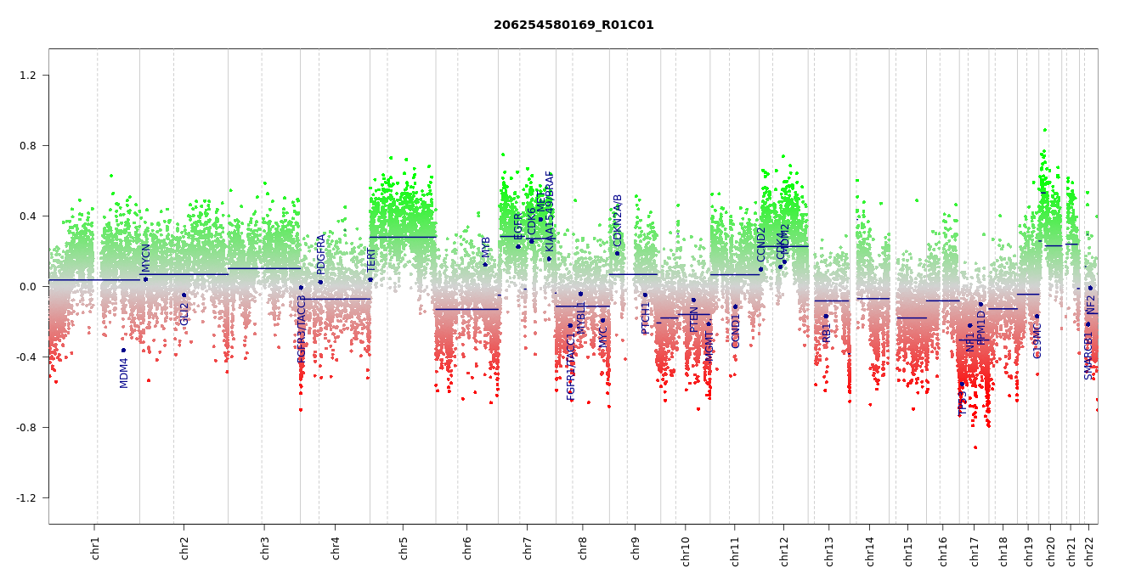
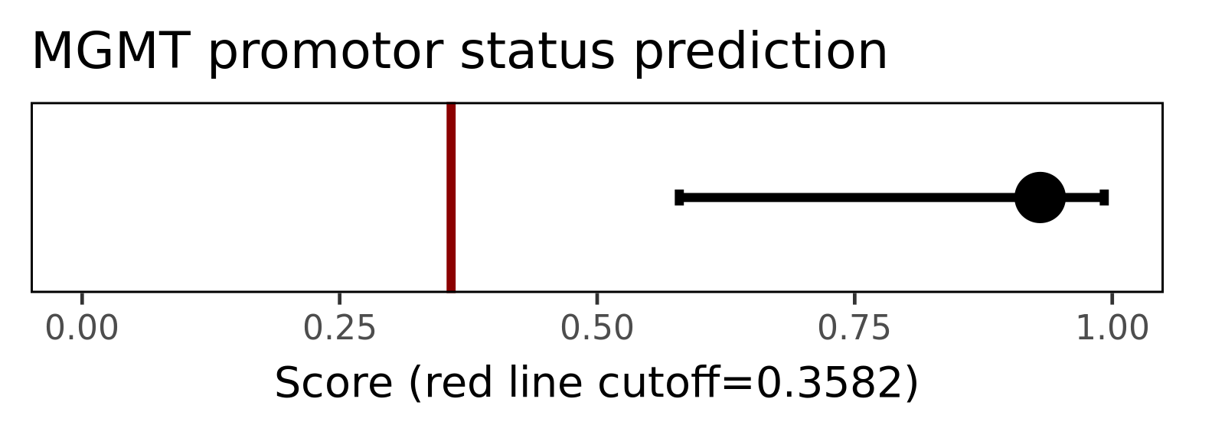

Slide 22
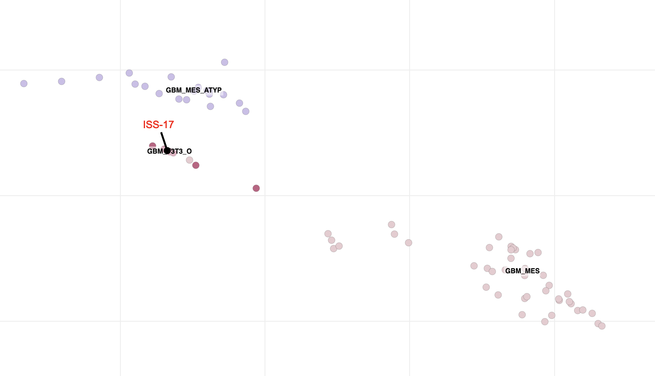
NIHSS platform
Mesenchimal GBM subtype with a low score sometimes plots under F3T3_O GBMs on NIHSS methylation platform. Important clinical implications for those with FGFR3-TACC3 fusion detected.
Not every F3T3 is a F3T3_O!

Slide 23
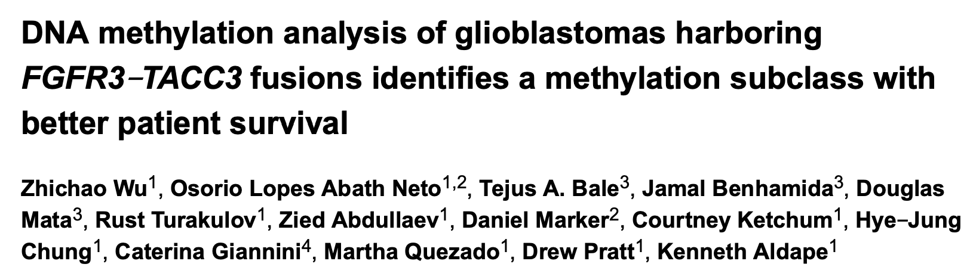
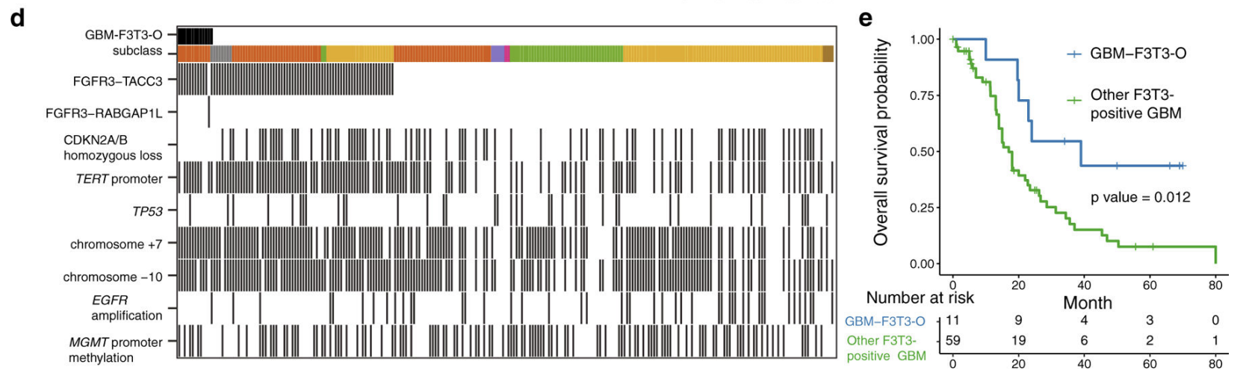
FGFR3-TACC3 fusions are seen in 3.1-11.7% of GBM cases with better survival.
From a cohort of 79 F3T3-positive GBMs, an outlier subgroup of 11 patients and an additional FGFR3-RABGAP1 fusion are reported in this study.
Samples were previously classified as GBM-mes (v11 DKFZ), and on v12 DKFZ top scores were seen on gangliogliomas
Many patients with oligo-like morphology and classical GBM morphology

Slide 24







FGFR3-TACC3
CNV map showing +7-10 and gains on fgfr3-tacc3 region

Slide 25





Meningiomas – a brand-new scenario

Slide 26


Meningiomas are still challenging
46 yo-male
ALL at the age of 10 (RT in 1988 – INCA RJ)
A right frontal 7cm meningiomas was diagnosed at the age of 39 (2017)
2018 – SSS invasion, reoperated
2019, 2021 and 2022 – reoperated (local progression)
43 yo-female
NHL in 2005 – head and neck RT
2023 presented with secondary headaches
A left frontal meningiomas was disclosed after MRI

Slide 27



Slide 28









MOLECULAR EVALUATION
NGS pannel not performed

Slide 29

MOLECULAR EVALUATION
NGS pannel not performed
Grau histológico: (1)
Classe de metilação: maligno (4)
Perdas cromossômicas em 1p, 6q e 14q: 2 presents (2)
Modelo integrado de estratificação de risco: Alto risco (Escore total 7)

Slide 30
Lessons I learned so far...
WHO2021 5th CNS classification for meningiomas are focused on idiopathic meningiomas. Radioinduced meningiomas needs a more careful evaluation, since they are usually more aggressive.
All meningiomas should have a methylation profiling evaluation
An integrated molecular-morphologic classification is warranted
Grade 2 meningiomas needs better molecular characterization

Slide 31
Methylation profiling in Neuro-Oncology
An important clinical tool for molecular classifying our tumors, and sometimes the only tool capable to diagnose some tumors (high-grade astrocytoma with piloid features)
IT DOES NOT SUBSTITUTE TRADITIONAL PATHOLOGY, NOR RADIOLOGY
NOT SUITABLE FOR GRADING
Multiple platforms and cohorts are better defining its usage in neuro-oncology
It`s getting clinicians and pathologist closer to each other, and helping patients to better understand their disease
Could it be a surrogate biomarker for some actionable molecular alterations? (IDH, EGFR, H3K27M, etc.)

Slide 32



TREATMENT TIMING AND MOLECULAR EVALUATION
24 yo-female patient from Australia (natural from Uruguai)
April 23 epileptic seizure
Brain MRI disclosed a solid-cystic mass on her left frontal lobe
May 23 neurosurgery with GTR

Slide 33

External molecular evaluation
Pesquisa | Resultado
IH+AP inicial | Neoplasia ependimária atípica de alto grau
Ki-67 | até 40% + necrose
Codeleção 1p/19q | Negativa (FISH)
Amplificação EGFR | Negativo
Deleção homozigótica CDKN2A/B | Negativo
Mutação IDH1/2 | Negativo (NGS)
Mutação BRAF | Negativo
Mutação H3F3A | Negativo
Mutação pTERT | Negativo
Expressão ATRX | Sem perda de expressão
YAP1 (IH) | Positivo
Metilação MGMT | Não metilado
BCOR | Negativo

Slide 34





Slide 35


29/08/2023 -> 11/09/2023 CyberKnife 45Gy em 10 frações
25/09/2023 -> 12/02/2024 6 ciclos de TMZ (150-200mg/m2)

Slide 36





Slide 37
CONCLUSIONS
The fifth edition of WHO CNS tumors demonstrates how molecular and histopathological changes together can better diagnose tumor types.
Even so, we need to be cautious and understand that the classification is in full evolution.
Tumor methylation profiling is a great diagnostic aid, but experience with the platform is still necessary. We should never use the information in isolation but always in combination with traditional histopathological changes and other molecular alterations.

Slide 38
Obrigado!
Thank you!

